Slide 1

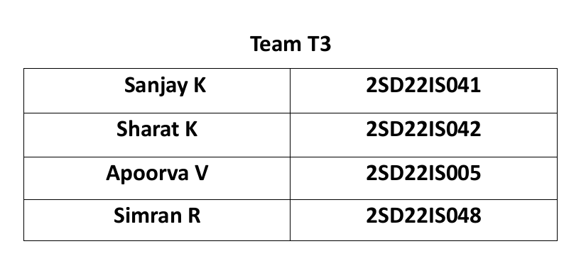
SDM COLLEGE OF ENGINEERING AND TECHNOLOGY DHARWAD, 580002
MINOR PROJECT- 2 IDEAS

Slide 2
1. Detecting Suspicious Call using AI
Existing System:
Current systems for detecting suspicious calls mainly rely on spam call blocking and caller ID identification. These solutions use databases of known scam numbers and keyword-based filters to flag potential threats. However, they are limited as they:
Primarily depend on known scam numbers, missing new or sophisticated fraud tactics.
Lack contextual understanding, leading to false positives or negatives.
Do not analyze real-time conversations, making them ineffective against social engineering tactics.

Slide 3
Proposed System:
The proposed system leverages AI and Natural Language Processing (NLP) to analyze audio recordings of calls in real-time. It detects suspicious activity by:
Requests for sensitive info (OTPs, CVVs).
Instructions to install remote access apps (Any Desk, TeamViewer).
Social engineering tactics to manipulate victim

Slide 4
2. Ride Sharing App
Existing System:
Current ride-sharing apps (e.g., Uber, Lyft) provide on-demand rides with real-time GPS tracking and multiple ride options. However, they:
Often focus more on private rides than true ride-sharing or carpooling.
May have high surge pricing and limited scheduling features.
Lack advanced route optimization for shared rides.

Slide 5
Proposed System:
The proposed app enhances ride-sharing by:
Focusing on carpooling with intelligent route matching for users traveling in the same direction.
Offering flexible scheduling and cost-sharing options.
Using advanced algorithms for efficient route optimization, reducing travel time and cost.

Slide 6
3.MokshaRites
Existing System:
Traditional way of performing rituals for the deceased
Many people live far from their ancestral home, making it difficult to perform last rites.
Busy schedules and modern lifestyles make it harder to follow lengthy rituals.
Busy schedules and modern lifestyles make it harder to follow lengthy rituals.

Slide 7
Proposed System:
Multi-Religious Ritual Services: Supports various religious traditions (Hindu, Christian, Muslim, Sikh, etc.)
Online Booking & Scheduling: Families can book rituals from anywhere
Live Streaming & Proof of Rituals: Families can watch rituals remotely or receive a certificate.
Emergency & On-Demand Rituals: Quick arrangements for unexpected deaths.
Donation & Charity Integration: Families can donate to temples or charities in memory of the deceased.

Slide 8
4. AI powered Plagiarism Checker
Existing System:
Current plagiarism checkers compare text with online databases and academic papers. However, they:
Often rely on keyword matching, leading to inaccurate results
Struggle with paraphrased content detection.
Have limited language support and outdated databases.

Slide 9
Proposed System:
The proposed AI-powered checker enhances accuracy by:
Using NLP to detect paraphrasing and contextual similarities.
Comparing text with real-time web content and academic databases.
Providing detailed, user-friendly reports with source links and rephrasing suggestions.

Slide 10
5.Social Networking App
Existing System:
Current social networking apps (e.g., Facebook, Instagram) offer content sharing, messaging, and community building. However, they:
Often prioritize ads and algorithms over user privacy and content reach.
Have complex interfaces with overwhelming features.
Lack ideal community focus and personalized user experiences.

Slide 11
Proposed System:
The proposed app enhances social networking by:
Offering a clean, ad-free interface with customizable privacy settings.
Focusing on niche communities with interest-based groups and content feeds.
Using AI for personalized content recommendations while maintaining data security.

Slide 12
6. Finance Advisor App
Existing System:
Current financial advisory platforms provide investment tracking, budgeting tools, and basic product comparisons. However, they:
Often offer generic advice with limited personalization.
Rely on static financial models, lacking real-time data analysis.
Have complex interfaces that may not cater to all user demographics.

Slide 13
Proposed System:
The proposed platform enhances financial advisory by:
Using AI to provide personalized financial plans and investment recommendations.
Offering dynamic budget analysis, real-time tracking, and tailored retirement planning.
Comparing financial products based on user-specific needs and goals. • Providing educational resources to improve financial literacy.

